Slide 1
Slot 2 Introduction to PFC
Languages and C Compilers
First Program in C
Notes:
Compilers ( Trình biên dịch ) : a computer programme – is used to translate the high-level language -> machine language

Slide 2
Objectives
This chapter supplies basic concepts in computer programming. After studying this chapter, you should be able to:
Define some concepts ( khái niệm )related to programming
Explain how to make a good software
Understand steps to develop a software
Explain ways for representing data
Answer why C is the first language selected
Understand how a C program can be translated and execute ( thực thi )
Discuss about notable features ( đặc điểm nổi bật ) of the C language
Understand a C program structure

Slide 3
Contents
Definitions
How to make a good software?
Steps to develop a software?
Computer hardware.
Data Units
Data Representation
Addressing Information
Program Instructions
Languages
Translate and execute a program
Why C is the first language selected?
Some notable features of C
Structure of a simple C Program.

Slide 4
1- Definitions
Information: Knowledge about something
Data: Values are used to describe information. So, information can be called as the mean of data
Problem: A situation in which something is hidden
Solve a problem: explore the hidden information
Solution: Value(data) of hidden information
Algorithm: a way to find out a solution
Program: A sequence of steps to find out the solution of a problem. An algorithm is a implementation ( qtrinh thực hiện, lên ý tưởng )of an problem
Computer program: a program is executed using a computer
Notes:
Data ( dữ liệu ) là những thông tin được mô tả bằng những giá trị
Algorithm : ( thuật toán ) là hướng tìm ra giải pháp, giải quyến vấn đề

Slide 5
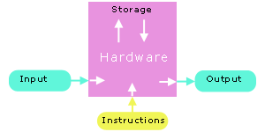
Definitions…
Computer program = data + instructions
A simulation ( mô phỏng ) of solution.
Is a set of instructions that computer hardware will execute
➔Increase performance of standard workflow (qui trình làm việc )
Pn
P1
P2
Computer software:
- A set of related programs
P3
Pn

Slide 6
2- How to make a good software?
Issues for a program/software:
Usability: Users can use the program to solve the problem
Robust ( strong, reliable ) and user-friendly ( than thiện vs ng dùng ) interfaces
Correctness: Solution must be correct
Comprehensive ( đầy đủ, toàn diện ) testing
Maintainability (dễ bảo trì ): The program can be modified easily
Understandability
structured programming
internal documentation
Modifiability
standards compliance
Portability ( khả năng di động ): The program can run in different platforms
standards compliance → Needed modifications are minimum
(platform: CPU + operating system running on it)

Slide 7
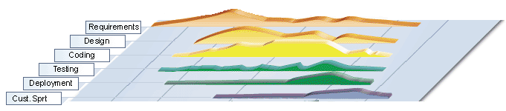
3- Steps to develop a software
Requirements → The problem is understood
Analysis → Data and tasks are identified
Design → folders, files are organized
Coding → Implementation
Testing → Checking whether requirements are satisfied or not
Deploying → Program is installed to user computers
Maintenance → Needed modifications(điều chỉnh), if any, are carried out

Slide 8
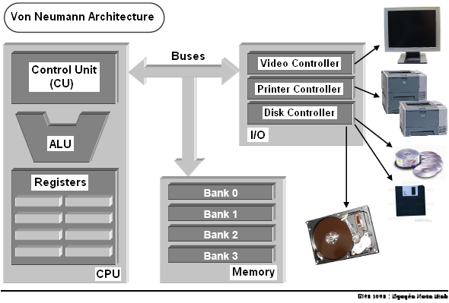
4- Computer Hardware - Review
3 steps to read a memory cell:
CPU puts the memory address to address bus
CPU puts the read-signal to control bus.
Data in memory cell is transferred to a register in CPU
ALU: Arithmetic and Logic Unit
Bus | Used to
Address bus | Determine the IO peripherals(thiết bị ngoại vi), position of accessed memory.
Data bus | Transmit data
Control bus | Determine operation on peripherals, read peripheral ‘s states
Notes:
CPU ( CU, ALU, Register ) + Memory + I/O devices : thourgh BUS

Slide 9
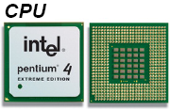
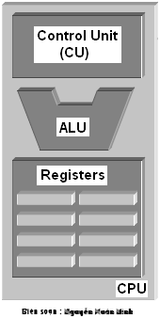
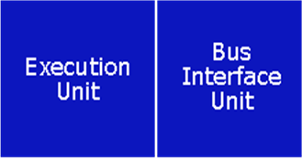
Computer Hardware…
The most expensive and fastest memory - registers - is reserved for the CPU.
CPU transfers information at less than 10 nanoseconds
primary memory transfers information at about 60 nanoseconds
a hard disk transfers information at about 12,000,000 nanoseconds
CPU memory is volatile - the contents of the registers are lost as soon as power is turned off.

Slide 10
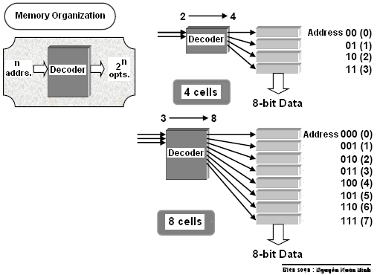
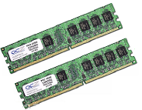
Computer Hardware…
Primary Memory
Primary memory holds the information accessed by the CPU.
Primary memory is also volatile. ( biến động )
The popular term for primary memory is RAM (Random Access Memory).
A specific memory cell ( vi, mạch ) is identified uniquely by a decoder. Decoder has n inputs and 2^{n} outputs. With a specific input, only one output is chosen (value=1), others having the value 0

Slide 11
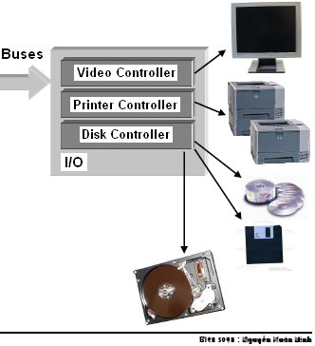
Computer Hardware…
Devices
Include basic I/O devices such as a keyboard, a monitor and a mouse…
Storage devices such as a floppy drive, a hard drive and a CD-ROM drive (secondary storage).
All device interfaces connect to the system buses through a central controller.

Slide 12
5- Data Units
Transistor (linh kiện bán dẫn )is the basic physical unit for storing data → Binary format
John von Neumann selected binary (base 2) digits as the EDVAC's fundamental unit.
The vast majority of modern computers process and store information in binary digits.
We call a binary digit as a bit.
Nibble = 4 consecutive bits.
Byte = 8 consecutive bits
= 2 nibbles
Unit of memory is BYTE
Byte
Nibble |  |  |  | Nibble
Bit | Bit | Bit | Bit | Bit | Bit | Bit | Bit
00000000 <- possibility 0 00000001 <- possibility 1 00000010 <- possibility 2 00000011 <- possibility 3 00000100 <- possibility 4 ... 00111000 <- possibility 104 ... 11111111 <- possibility 255
Notes:
Transitor is used to switch electronic signals
EDVAC là một máy tính điện tử chương trình lưu đồ đầu tiên, được thiết kế bởi John von Neumann vào năm 1945.
Một "nibble" là một nhóm 4 bit liên tiếp => 2 nibble có 8 bits

Slide 13
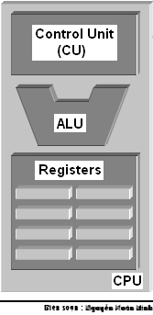
Data Units …
The natural unit of the CPU is a word.
The word length is number of bits of a general register within CPU(CPU memory).
Word length can be 8, 16 (old CPUs), 32, 64 (current CPUs)

Slide 14
6- Data Representations
Data in computer are binary values → They can be treated as numbers.
3 common number systems:
Decimal Representation
Hexadecimal Representation
Base 16: 0, 1, …, 9, A, B, C, D, E, F
Each hexadecimal digit represents 4 bits of information.
The 0x prefix identifies the number as a hexadecimal number: 0x5C
Octal Representation
Base 8: 0, 1, 2, .., 7
Set of 3 consecutive bits forms an octal digit
The prefix 0 identifies the number as an octal number: 031
We can convert a number in one system to another ( introduced in the subject Introduction to Computing) → Next 12 slides will be read by yourself. Use your notebook for doing exercises.

Slide 15
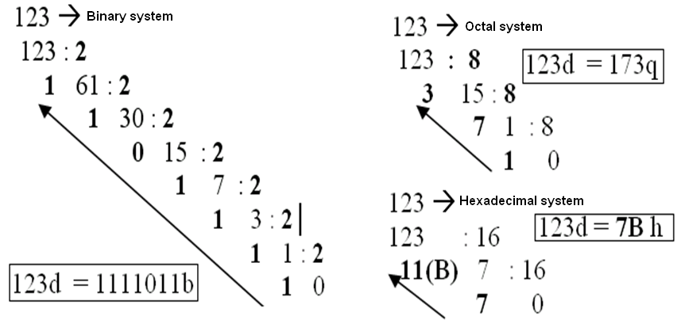
Data Representations: Conversion- A review
Read by yourself
Notes:
Chuyển 1 con số -> hệ Nhị : devide each for “ 2” then write a “ remainder “ on a side & “ result “ below. Then…continue and we have a result is the “ range “ of the “ remainder “ from the “bottom to the top “
Chuyển 1 con số -> hệ Bát : similar to Binary
*) -> hệ thập lục : 10 = A , 11 = B ,…

Slide 16
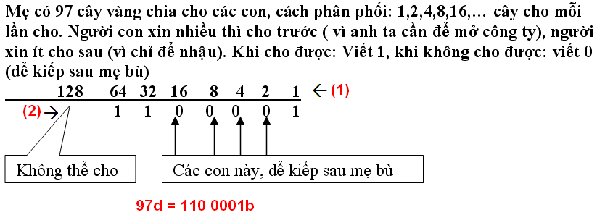
Data Representations: Conversion: A review
Read by yourself
97 → Binary system

Slide 17
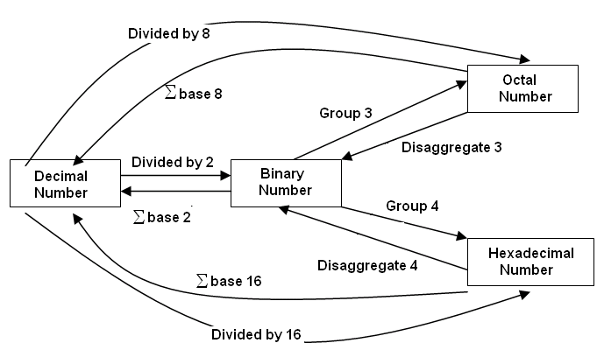
Data Representations: Conversion: A review
Read by yourself
Summary
Notes:
Group 3: nhóm 3 bit lại
Disaggregate : Từ ( Octal, Binary ) -> Bina : Phân tách thành 3,4 số ( 0,1)
Từ Dec -> ( Bina,Octal,Hexa) : chia lấy remainder cho (2,8,16)
Từ Bina -> Dec; Octal -> Dec ; Hexa -> Dec . Nhân với cơ số 2 Mũ ( … -2,-1,0,1,2,..)

Slide 18
Data Representations: Conversion…
Read by yourself
Computer is a binary device → All data are stored in binary format
Decoding (restore) to the normal description
3
Number:
3
Encode
(Another format is chosen)
00110011
Normal description (human being)
3

Slide 19
Data Representations: Conversion…
Fill the corresponding binary expansions of the following decimal number:
Decimal | 4-bit Binary | Decimal | 8-bit Binary | Decimal | 16-bit Binary
9 | 1001 | 7 | 0000 0111 | 255 | 0000 0000 1111 1111
7 | 0111 | 34 |  | 192
2 |  | 125 |  | 188
15 |  | 157 |  | 312
12 |  | 162 |  | 517
11 |  | 37 |  | 264
6 |  | 66 |  | 543
5 |  | 77 |  | 819
8 | 1000 | 88 |  | 1027
13 |  | 99 |  | 2055
14 |  | 109 |  | 63
Do by yourself

Slide 20
Data Representations: Conversion…
Do by yourself
Fill the blank cells
Decimal | Binary | Hexa. | Decimal | 16-bit Binary | Hexadecimal
9 | 1001 | 9 | 255 | 0000 0000 1111 1111 | 00FF
127 | 0111 1111 | 9F | 192
125 |  |  | 188
157 |  |  | 312
162 |  |  | 517
37 |  |  | 264
66 |  |  | 543
77 |  |  | 819
88 |  |  | 1027
99 |  |  | 2055
109 |  |  | 63

Slide 21
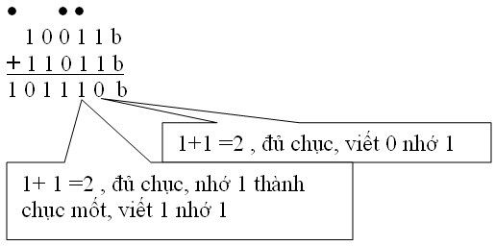
Data Representations: Operations
Read by yourself
Do yourself:
3245q + 247q
1A7Bh + 26FE7h
101101111 b
100111011 b
110110001 b
110001101b
+

Slide 22
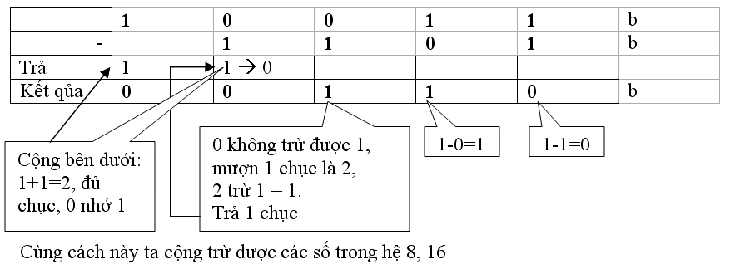
Data Representations: Operations …
Read by yourself
Do yourself
1101101101b - 10110111b 3654q – 337q 3AB7h – 1FAh
36Ah – 576q = ? h 64AEh – 1001101b= ? q

Slide 23
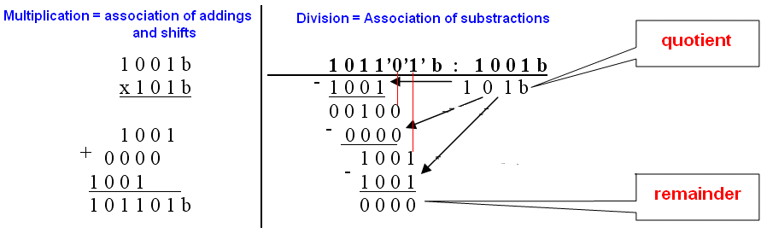
Data Representations: Operations …
Read by yourself
Exercises :
1011010 b* 1011b
1101000b + 2AB h + 345 q = ? h = ? q
3AFh / 1Ch =? b = ?d
3ACh – 562q = ?b = ? d
3FFA h / 327q = ?b = ? d

Slide 24
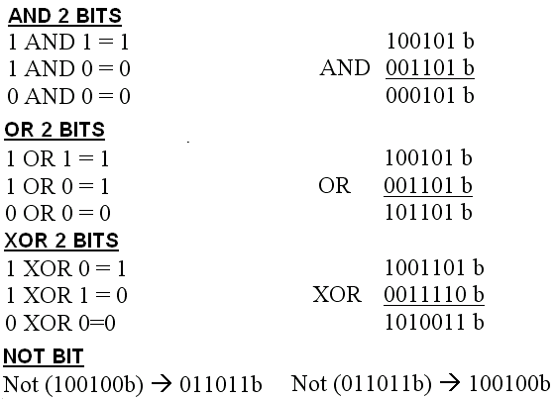
Data Representations: Operations …
Read by yourself

Slide 25
Data Representations: Signed Integers
Representing negative integer
67d , 1 byte → 01000011
➔-67d → 11000011
Check: 67 + (-67) =0
0100 0011
+ 1100 0011
10000 0110 → False
Solution: Use 2-complement format
(+67) → 0100 0011
1011 1100 ( 1-complement/reverse bits/ Not operator)
+ 1
(-67) 1011 1101 (2-complement)
Check:
(67) 0100 0011
(-67) 1011 1101
+ 0 0000 0000
Read by yourself
The leftmost bit is the sign bit.
0:positive, 1:negative
Positive representation ← 2-complement → negative representation

Slide 26
Data Representations: Signed Integers
Read by yourself
Give binary representation of –35 using 1 byte
Solution: +35 → binary representation → 2-complement → Binary representation of -35
Give the decimal of the binary presentation of a signed one-byte integer 11111100 b
Leftmost bit is 1 → This is a binary representation of a negative integer.
1111 1100 →2-complement format→ positive number → Decimal number n → -n is the value of this representation
Exercises
Show binary formats of 1-byte unsigned numbers:
251 , 163, 117
Show binary formats of 2-byte unsigned numbers:
551 , 160, 443
Show binary formats of 1-byte signed numbers:
-51 , -163, -117, 320
Show the decimal values of 1-byte unsigned representations: :
01100011 b , 10001111 b , 11001010 b , 01001100 b

Slide 27
7- Addressing Information
Each byte of primary memory has a unique address (order number), starting from zero
Kilobyte = 1024 bytes
Kilo K= 1024 ( 2¹⁰)
Mega or M (=1024k)
Giga or G (=1024M)
Tera or T (=1024G)
Peta or P (=1024T)
Exa or E (=1024P)
Addressible Memory
The maximum size of addressable primary memory depends upon the size of the address registers
 | MEMORY
… | …….
5 | 1010 1010
4 | 0011 1100
3 | 0101 0100
2 | 1001 0000
1 | 1100 1011
0 | 0100 0001
B: byte
b: bit
Address
value

Slide 28
8- Program Instructions
01001011 | 100110110110 | 011011010111
Opcode | Operand 1 | Operand 2
Each program instruction consists of an operation and operands
The CPU performs the operation on the values stored as operands or on the values stored in the operand addresses.
Operands: Constants, registers, primary memory addresses

Slide 29
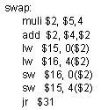

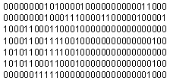
Program Instructions…
High-level language code
Assembly
(low-level)
code
Machine (binary)
code
compiler
assembler

Slide 30
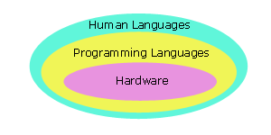
9- Programming Languages
Programs that perform relatively simple tasks and are written in assembly language contain a large number of statements.
Machine Language → Assembly language → High-level languages,
To make our programs shorter, we use higher-level languages.

Slide 31
Programming Languages…
5 Generations of Programming Languages:
(1) Machine languages.
(2) Assembly languages.
(3) Third-generation languages. These are languages with instructions that describe how a result is to be obtained (C, Pascal, C++, Java…).
(4) Fourth-generation languages. These are languages with instructions that describe what is to be done without specifying how it is to be done (SQL).
(5) Fifth-generation languages are the closest to human languages. They are used for artificial intelligence, fuzzy sets, and neural networks (Prolog, Matlab)

Slide 32
Programming Languages…
The higher the level, the closer to the human languages and the further from native machine languages
Each third generation language statement ~ 5-10 machine language statements.
Each fourth generation language ~ 30-40 machine language statements.

Slide 33
10- Translating and Executing a Program
Program code in a high level language can not run, It must be translated to binary code (machine code) before running.
2 ways of translations:
Interpreting: one-by-one statement is translated then run → Interpreter
Compiling: All statements of program are translated then executed as a whole → Compiler
C translator is a compiler

Slide 34
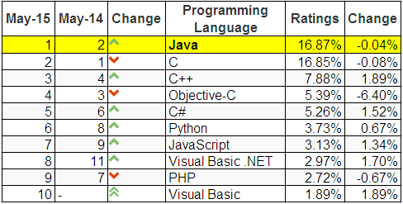
11- Why C is the 1st Language?
Top ten common programming languages:
From http://www.tiobe.com/index.php/content/paperinfo/tpci/index.html

Slide 35
Why C is the 1st Language?
C is one of the most popular languages in use globally
Some reasons for learning programming using the C language include:
Language | Time to Run
Assembly | 0.18 seconds
C | 2.7 seconds
Basic | 10 seconds
Comparative times for a Sieve of Eratosthenes test
C is English-like,
C is quite compact - has a small number of keywords,
A large number of C programs need to be maintained,
C is the lowest of high-level languages,
C is faster and more powerful than other high-level languages,
The UNIX, Linux and Windows operating systems are written in C and C++.
The most common languages, such as Java, C#, are similar to C.
C supports basic ways which help us understanding memory of a program. These can be hidden in higher languages.

Slide 36
12- Some Notable C Features
Comments
/* */
We use comments to document our programs and to enhance their readability. C compilers ignore all comments.
Whitespace
We use whitespace to improve program readability and to display the structure of our program's logic. C compilers ignore all whitespace
Case Sensitivity
C language is case sensitive.
C compilers treat the character 'A' as different from the character 'a' .

Slide 37

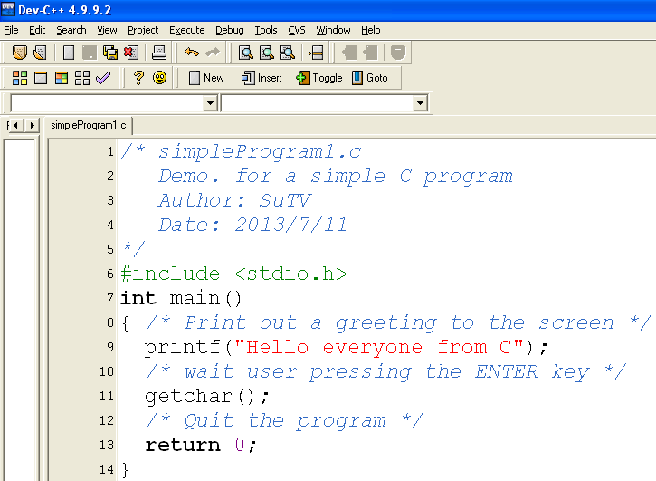

13- Structure of a Simple C Program
Comment for program description
Declaration for library using
Entry point of C-program
Statements + comments
Exit point of C-program

Slide 38
Structure…: C program Entry Points
Entry point: the point where a program begins.
Entry points of C-programs:
[int] main( [void] )
{ <statements>
[ return number; ]
}
Common form
[int] main( int argCount, char* args[])
{ <statements>
[ return number; ]
}
Demo.
In the module H (Files)

Slide 39
Summary
Definitions related to programming
How to make a good software?
Steps to develop a software?
Computer hardware.
Fundamental Data Units
Data Representation
Program Instructions
Languages
C Compilers
Why C is the first language selected?
Some notable features of C
Structure of a simple C Program.

